Slide 1
Lecture No 04

Slide 2




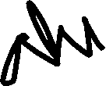
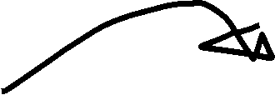









Slide 3
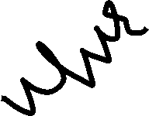


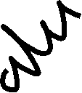













































Slide 4



























A system is said to be causal if its response is dependent upon present and past inputs, but doesn’t depend upon future input.
Present and Future than system is called as Non-Causal Systems

Slide 5



































































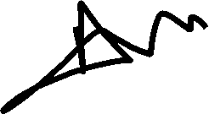







Slide 6



































































Slide 7




Slide 9




















Slide 10

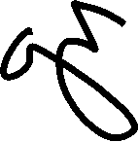



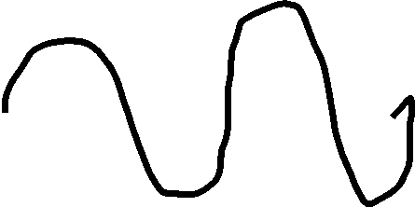













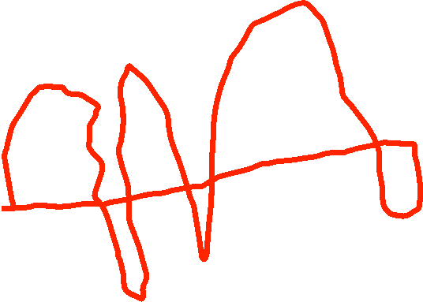






Slide 11








































Slide 12













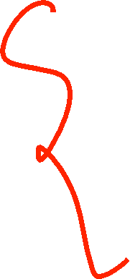







Slide 13





































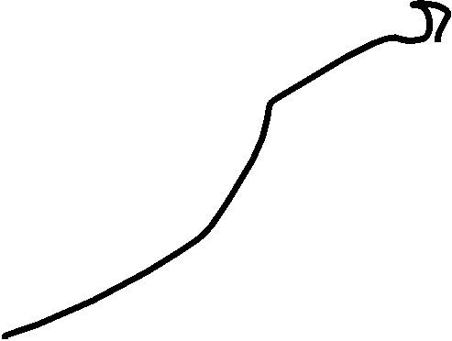















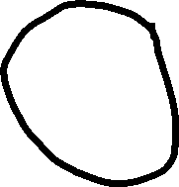






Q: Determine whether each of the following discrete time signal is Periodic. If it is Periodic, determine its fundamental period.

Slide 14
























































Slide 15






















































Slide 16





























































Slide 17



























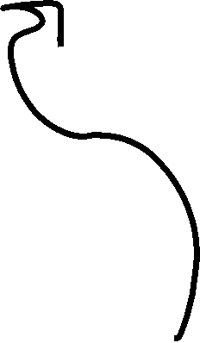









































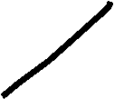















Slide 18


















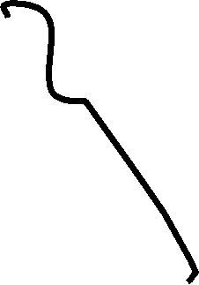
























































Slide 19




























































Slide 20






















































Slide 21

























































Slide 22













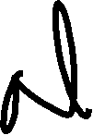











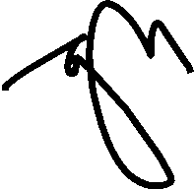














Slide 23



















































